Slide 1
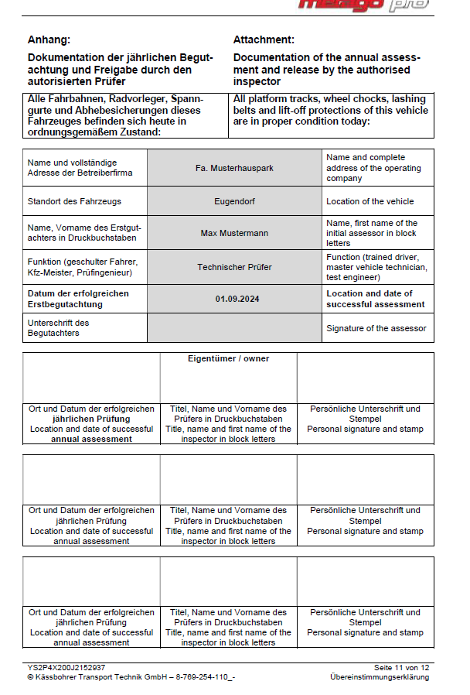
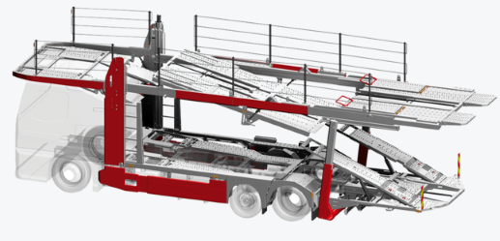
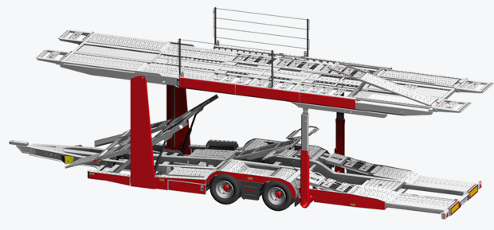
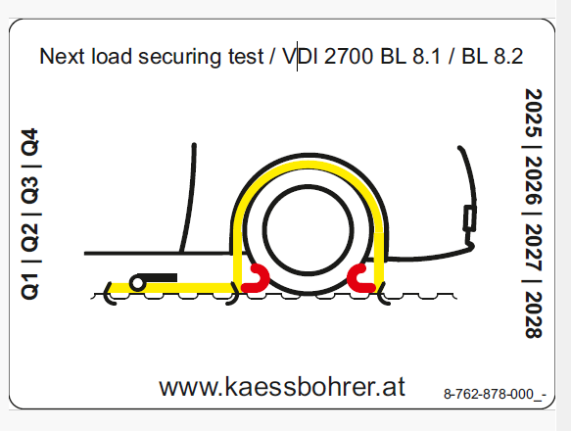

Documents and stickers Attachment
Required!
Have the motor vehicle and trailer certificate signed by the respective inspector, stamped by the company and carried in the vehicle.
Required Attach sticker with QR code in the driver's cab, driver's door inside! Easily accessible
STAMP
SIGNATURE
Optional: TÜV sticker visible on the side or rear of the vehicle
TÜV inspection sticker given If only required after 1 year
Follow-up inspections according to national regulations by authorised person or service
for load securing and enter them consecutively in the inspection log from page 11.

Slide 2
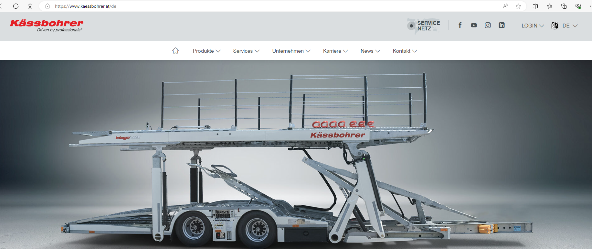
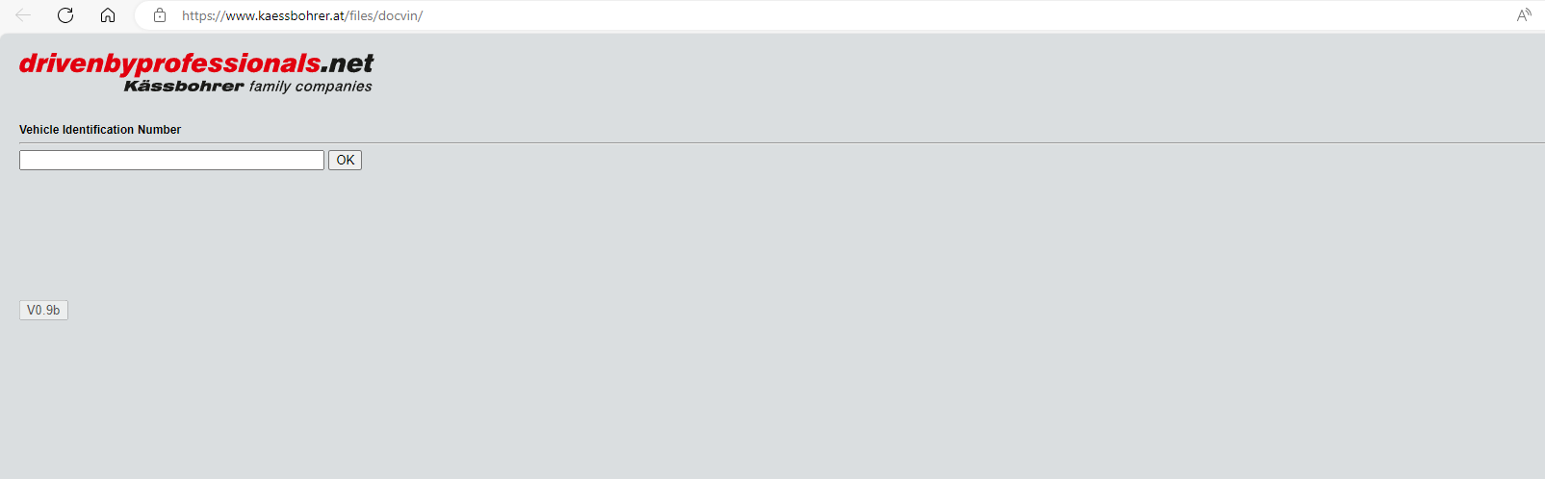
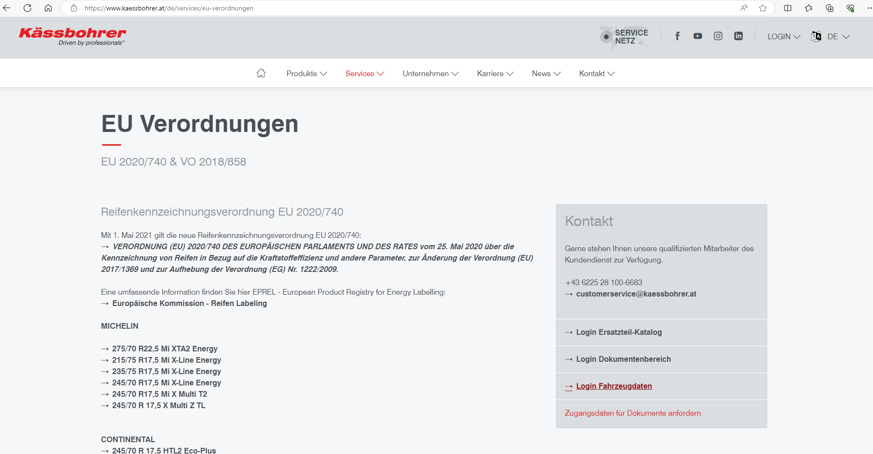
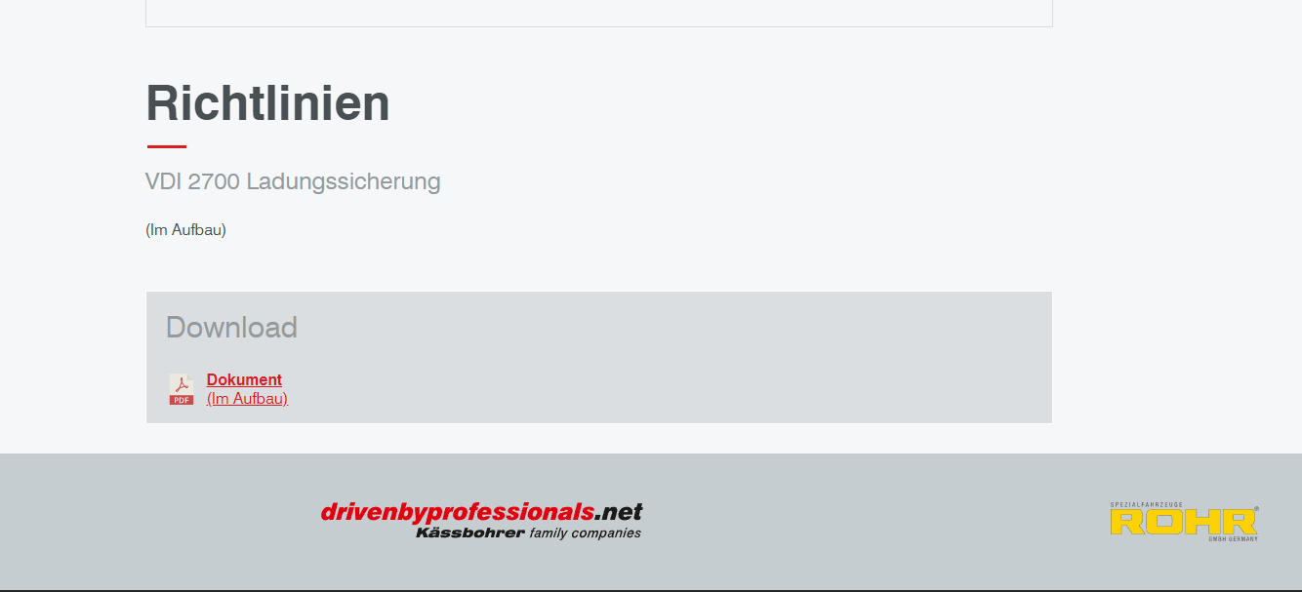
Homepage Kässbohrer:
Access via drop-down list at login (load securing) shortcut
Or Service / Regulations Download area for Excel and data sheets
Enter the chassis number of the trailer or lorry to call up the document
Note: The section Guidelines for load securing VDI2700 is currently under construction! And a status confirmation will be available soon.

